Slide 1
Signature Verification
Done-By:
Aswin Chander (19BCE1034)
Tarun R (19BCE1173)
Varun Shivakumar (19BCE1206)

Slide 2
Abstract
Signatures are the most often utilised mechanism for identifying people whose identities have been retrieved from prior signatures. The main point is that in a bank, signatures are extremely crucial because money withdrawals are dependent on them. Signature verification is one of the most widely utilised biometric procedures for personal identification. The signature verification procedure is based on human scrutiny of one known sample in many business circumstances, such as check payment. There are no ideal methods in place at banks to verify whether a signature on a check is genuine or not. This may result in bank fraud.The number of cases of signature fraud in banks is on the rise these days.The project will assist in determining whether a signature is genuine or not.Online and offline verification are the two methods of verification available.

Slide 3
Introduction
Essentially, we will implement How to determine whether a signature is genuine or not in this project. To begin, we'll use a signature database to teach the algorithm. The system has previously authorised this signature database. This system will examine all signatures and create a reference signature that will be used to verify other signatures.As a measure, several parameters (such as Euclidean Distance) exist in the feature space between the claimed signature and the signature to be investigated. The signature is determined as forgery if the absolute difference between the parameters of the original signature and the verification signature is larger than a pre-defined threshold.

Slide 4
Objective
SRVS (signature recognition and verification system) is a system that can handle two tasks: identifying the signature owner and determining whether the signature is genuine or forgery.Signature verification is divided into two categories here, depending to the needs of the problem at hand. a. Verification of signatures over the internet b. Signature verification offlineWhen a guy writes his signature, he provides additional information such as hand speed and pressure management, among other factors that can be used to determine if the image is genuine or counterfeit. This initiative will assist in resolving the issue of falsified signatures.

Slide 5
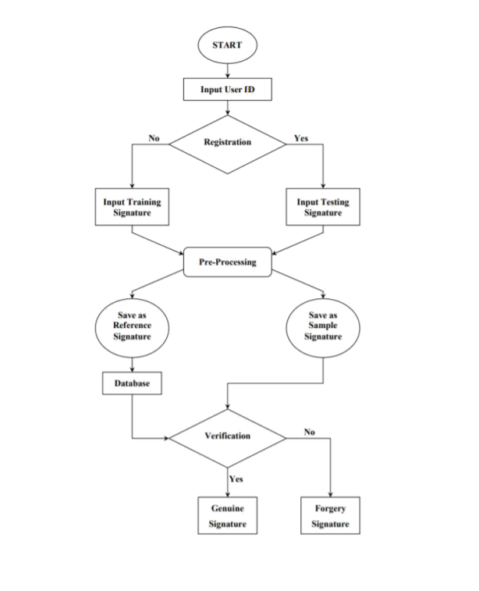
Methodology

